Slide 1
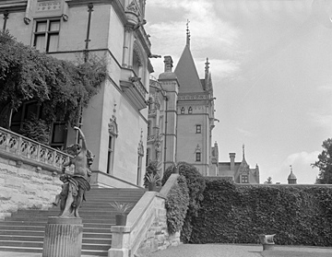
Biltmore house
Bitmore house is the house that slaves kept clean it never got mest up one bit it is locaed in asheville NC it is a clean giant house it was bulit in 1896 biltmore house is 30 feet tall.
Notes:
Title page: 0 /20
3 accurate facts: 60/60
1 image: 8/10
4th grade language: 5/10
Total: 73/100

Slide 2
O Henry
His name is William Sydney Porter
He was born in 1910
He is significant because he is one of the most famous short story writers in America

Slide 3
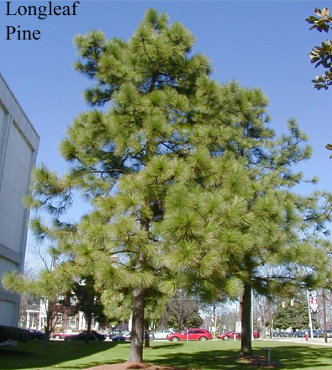
The state tree
The pine was offcilly designated as the state tree by the general assembly of 1936 sessnon laws 1963 c 41 and the tree is 50 years oldThe state tree the pine was offcially as early as 1959 the garden clubes of NC had began a campaign to name a state tree at there 1962 metting a poll was circelated to vauious member

Slide 4
State stone
Hunter
Notes:
Title page: 20 /20
3 accurate facts: 30 /60
1 image: 0/10
4th grade language: 8/10
Total: 58/100

Slide 5
Mrs rose
What she did for us

Slide 6
She gave me stuff for school and sport stuff

Slide 7
State stone
Why is it significant to nc THE bill to establish the emerald as the state ston when was is officially named january the 25 1973 what does look like green vityh ferry other interesting facts north carolina has only sifting emerald depoine north carolina

Slide 8
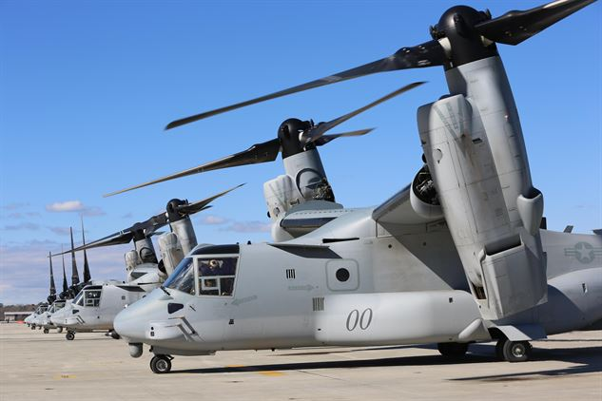
New bern slide show
joshua.n
Notes:
Title page: 20/20
3 accurate facts: 50/60
1 image: 10/10
4th grade language: 8/10
Total: 88/100

Slide 9
Fun facts of new bern
1.new bern is the second oldest town in nc
2. New bern was the capital of new bern but now it have burned down
3.it is in craven county between the trent and neuse river
4. It have a race on a brig that mrs kessel ran on ...

Slide 10
Wright brothers ,Tryon palace, state mammal
Notes:
Title page: 20/20
3 accurate facts: 60/60
1 image: 10/10
4th grade language: 10/10
Total: 100/100

Slide 11
Softball life

Slide 12
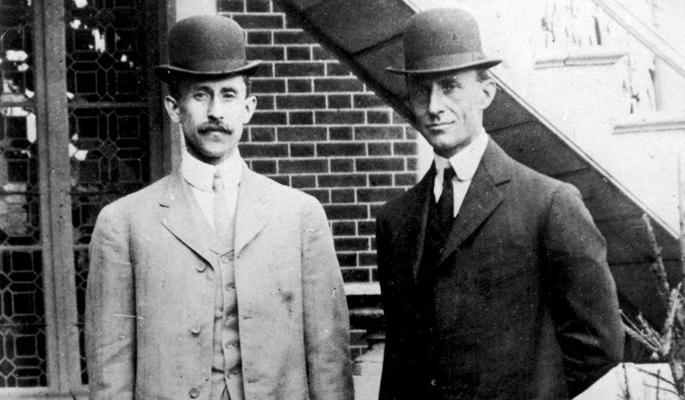
Wright Brothers
The Wright Brothers are significant NC because they made the first controlled heavier than air powered flights.They were part of NC history in Dec. 17th 1903. They lived in Dayton,Ohio. The Wright Brothers , Orville and Wilbur Wright are important.

Slide 13
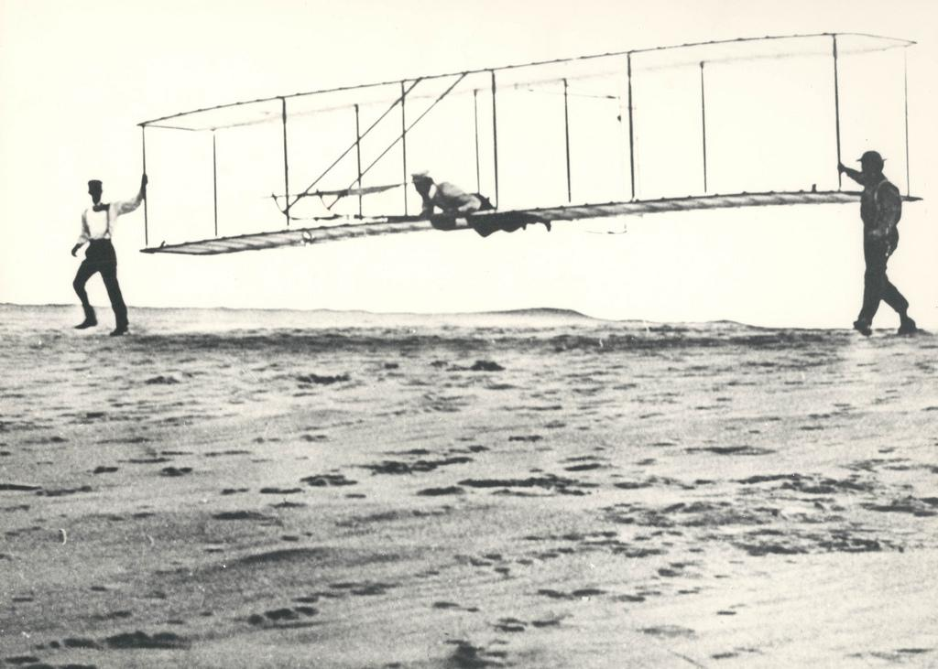
Other Interesting facts about the Wright Brothers
Some other interesting facts are there first flight was in Kill Devil Hills near Kitty Hawk. While making their test flights the Wright Brothers wanted a place with big winds, sand for some soft landings and they also wanted place to soar.

Slide 14
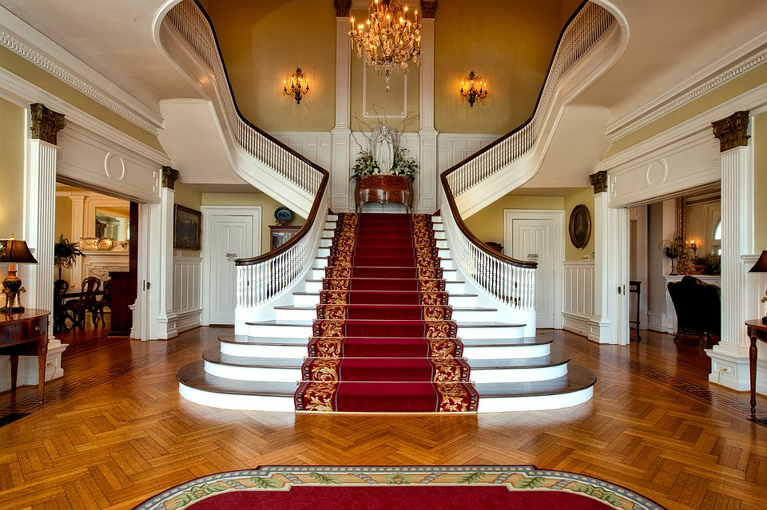
Tryon Palace
Tryon Palace was built for a home for the royal governor.
Tryon Palace is located in New Bern north carolina it was built in 1767.
The residence of the colonial governor at Newbern north carolina includes historical commentary about why these expenses infuriated many colonists.

Slide 15
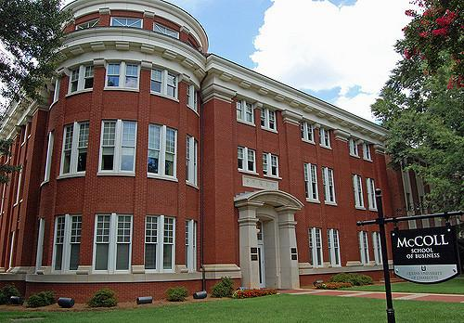
Tryon Palace
Tryon palace bad laid the groundwork for the building which would be known in his time as Tryon palace before he said from England for north carolina to assume his duties as lieutenant governor 1764.on 9 jan.1767 Hawks and Tryon palace executed a contract,which out lined the particulars for the construction ,which out lined the particulars for the construction of a massive brick structure with wings either side.

Slide 16
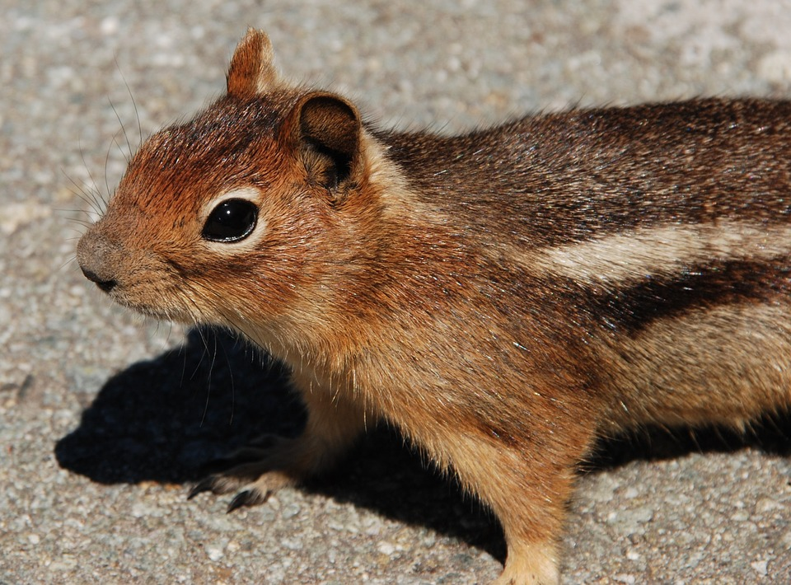
State mammal
The state mammal was officially named in 1969. Also in 9169 the lawyers or presidents said well are state mammal will be the gray squirrel.the gray squirrel looks like regular squirrel but it's the state mammal it has big fluffy tail.and its brown and gray all over. The gray squirrel is the state wild animal of kentucky and the state mammal of north carolina.

Slide 17
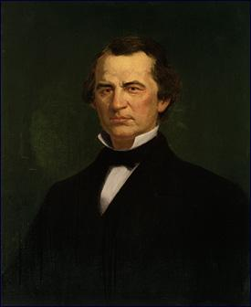
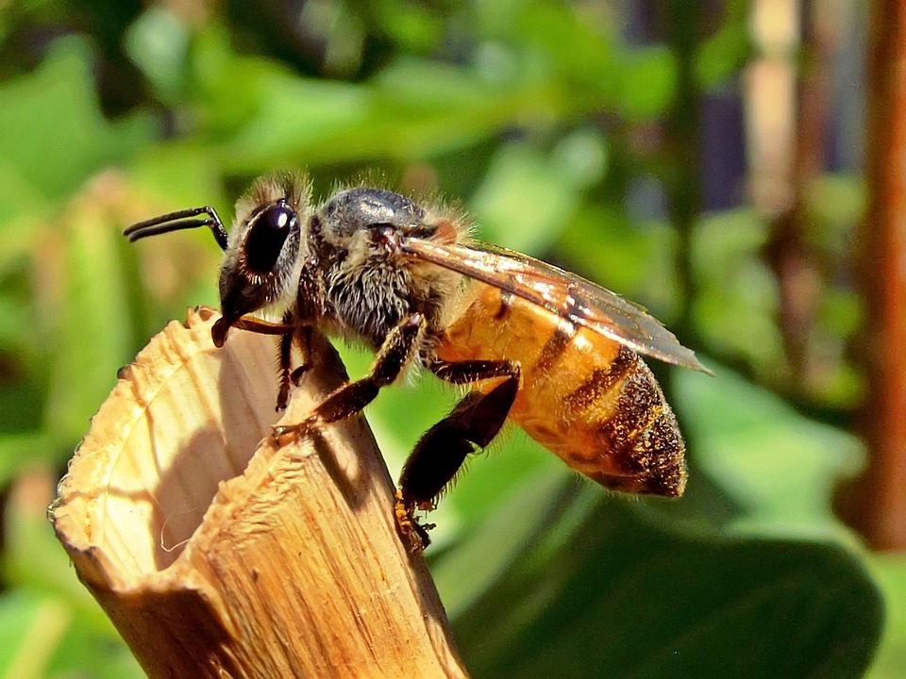
Let's learn about Raleigh ,honeybees and Andrew johnson
by:Sarah,bailey ,Erin
Notes:
Title page: 20 /20
3 accurate facts: 60/60
1 image: 10/10
4th grade language: 10/10
Total: 100/100

Slide 18
Raleigh
Where is Raleigh located?? Raleigh is located in NC.
Why is Raleigh significant to NC?? Raleigh is the capital of NC.
Fun facts- Raleigh grew very slow and experienced several devastating fires.Raleigh has several colleges established in the second half of the nineteenth century.Raleigh also has numerous .

Slide 19
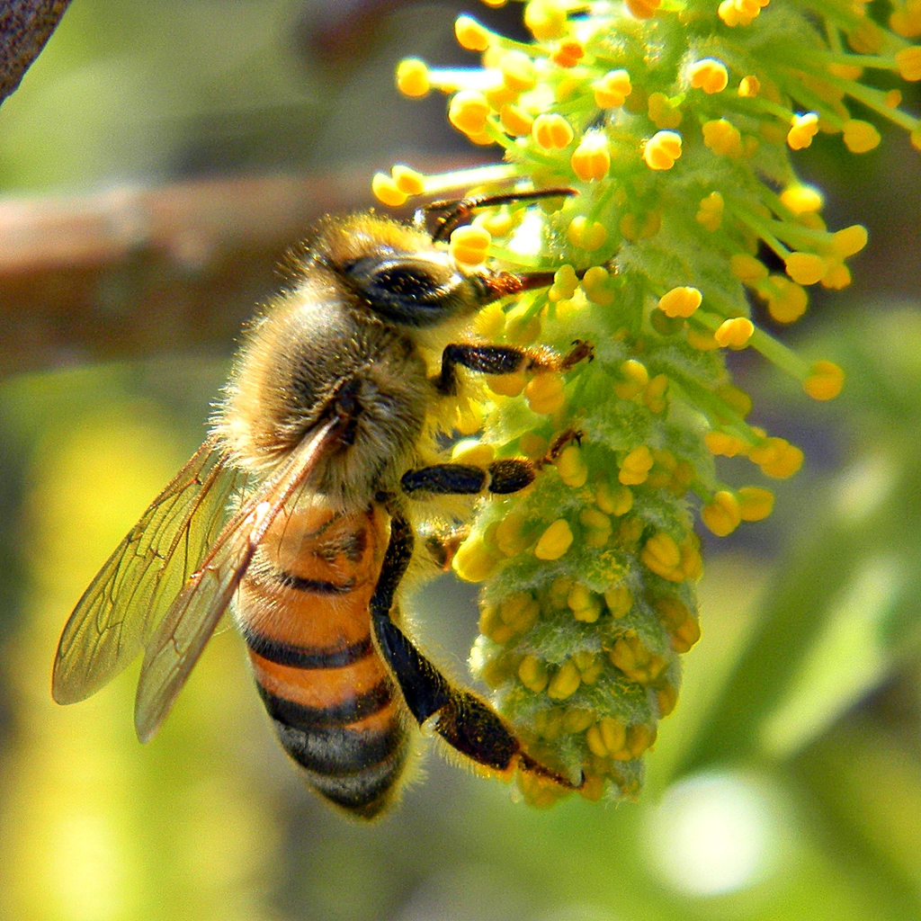
Honey bees
The honey bee was named the state insect in 1973.the honey bee produces honey for our state that's why it's significant for our state .by the mid 1700s beeswax used widely for candles and cosmetics .requiring little effort and high rewards the practice of beekeeping was well established across the state by 1800.honey bees have played an important role in ncs agricultural economy . native to europe, africa,and asia honeybees reached north america aboard english vessels as early as 1622.

Slide 20
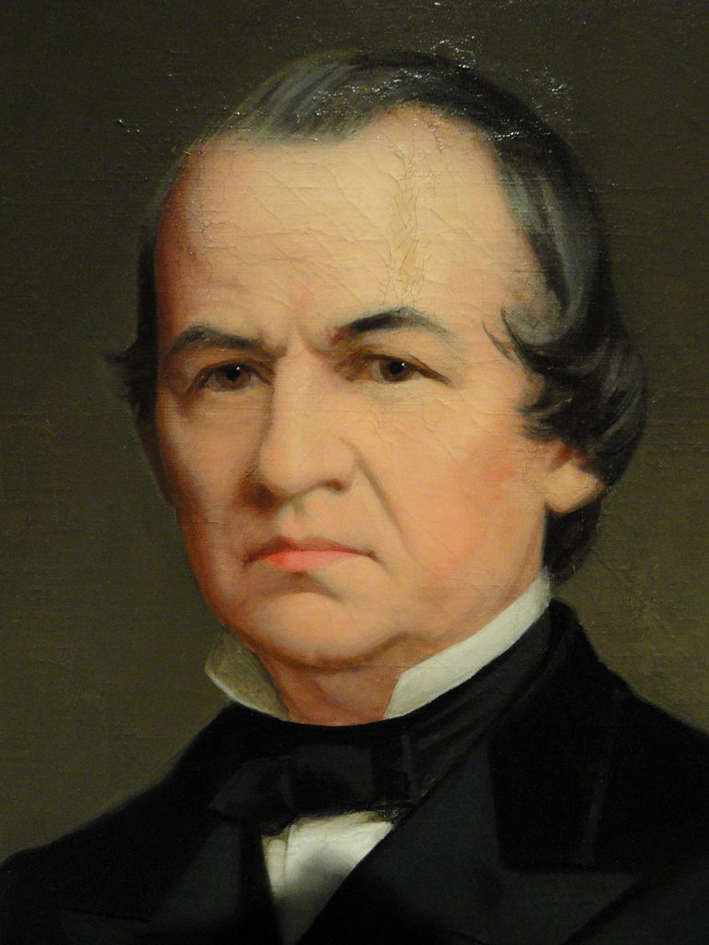
Andrew johnson
Why is he significant to NC?He is significant to NC for being the president to take over when Abraham lincoln died.When was he part of NC history?Andrew Johnson was the 17th president of the united States starting in 1865-1869.Where did he live in north carolina?Andrew lived in Raleigh he moved there when he was a teenageer.fun facts-he was born december 29th .He became mayor in 1834.

Slide 21
Cardinal , Kill Devil Hills And James K Polk
By : Rainey Keith , Taylin Waters , Rylee Harrison and Riley Tittle
Notes:
Title page: 20/20
3 accurate facts: 60/60
1 image: 8/10
4th grade language: 10/10
Total: 98/100

Slide 22
Cardinal
The Cardinal is our state bird . The Cardinal is significance to North Carolina because the cardinal was by no means at the session . Did you know that 10 years earlier they had a different state bird ? The cardinal is sometimes known as the Northern cardinal . The male cardinal is bright red , while the female cardinal´s are staying safe being mixtures of brown , gray and red. They do not migrate and stay in the united states all year long .

Slide 23
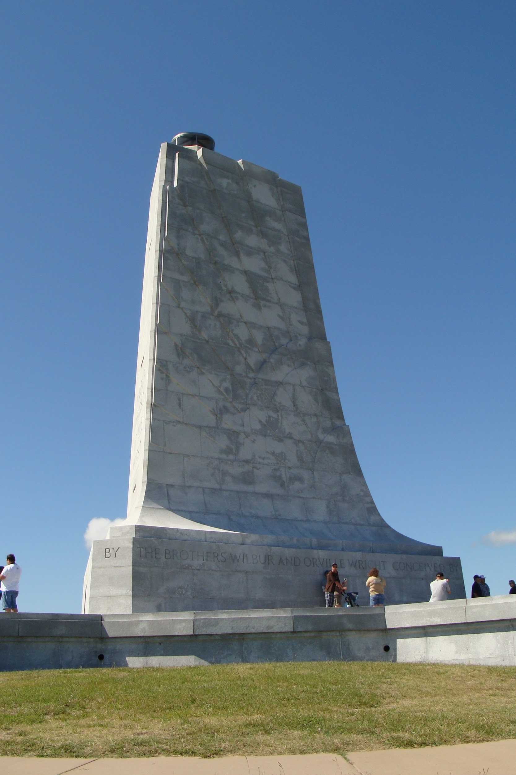
Kill Devil Hills
Kill Devil Hills is significant to North Carolina because that's where the Wright Brothers took their first flight.
Kill Devil Hills is located in the Outer Banks.
The Wright Brothers have a memorial in Kill Devil Hills that is 60 feet tall made with gray granite which is or state rock.

Slide 24
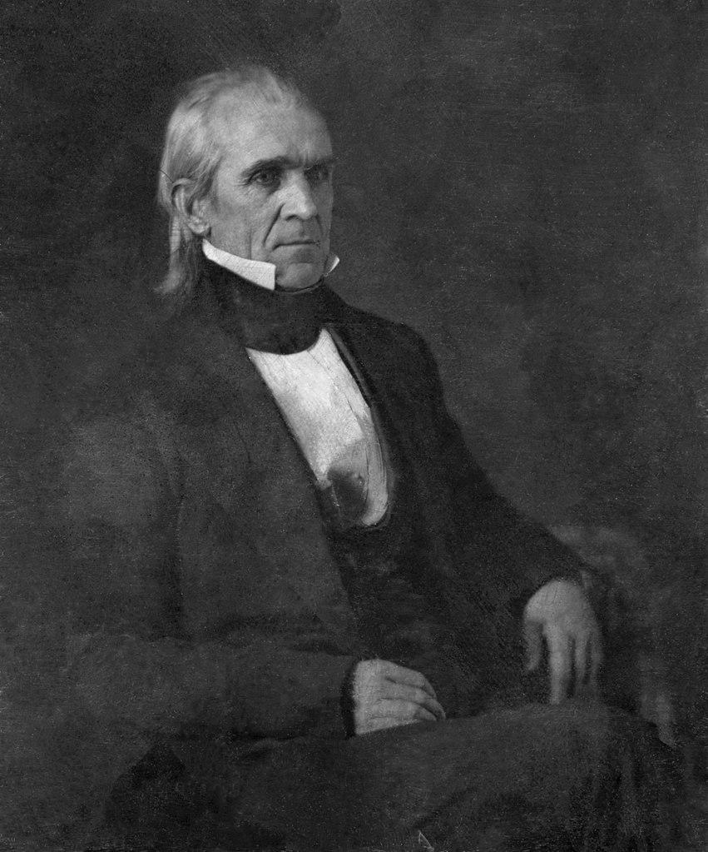
James K Polk
James K Polk was the 11 president of the United States.
Polk was apart of the united states from 1845-1849
James was born in mecklenburg county, NC and died in Nashville,Tennessee
He was married to sarah childress polk. They had no children
The K is for Knox in James K polk
Born: 11/02/1795 Died: 06/15/1849

Slide 25
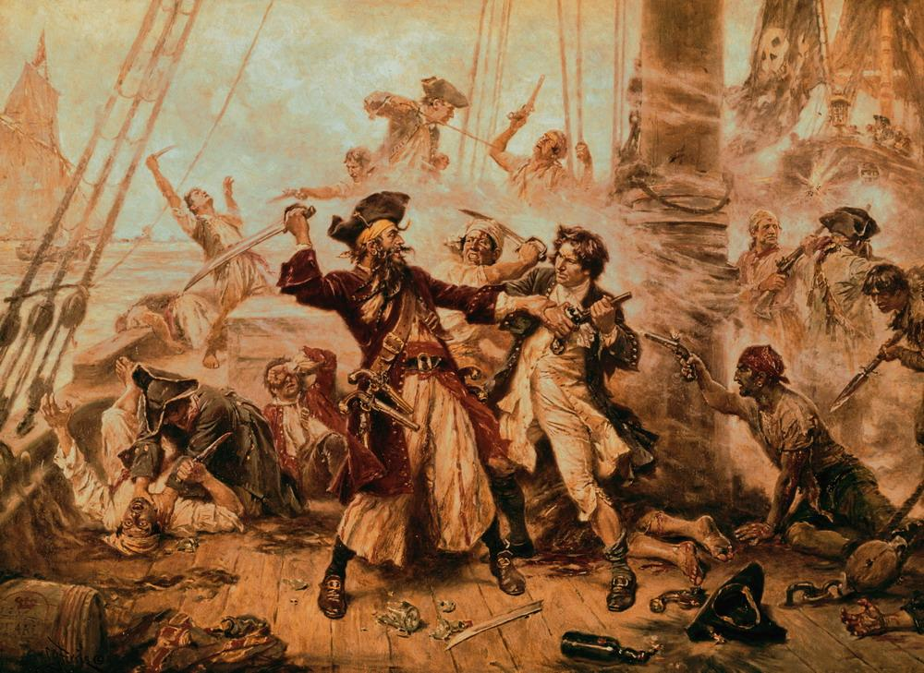
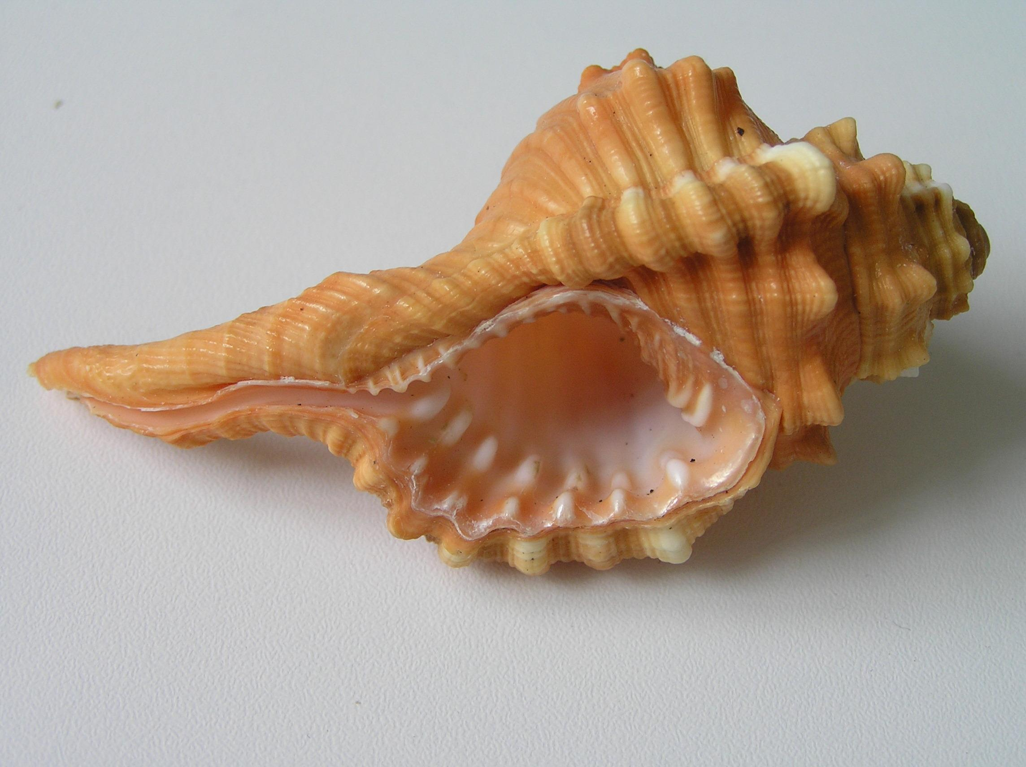
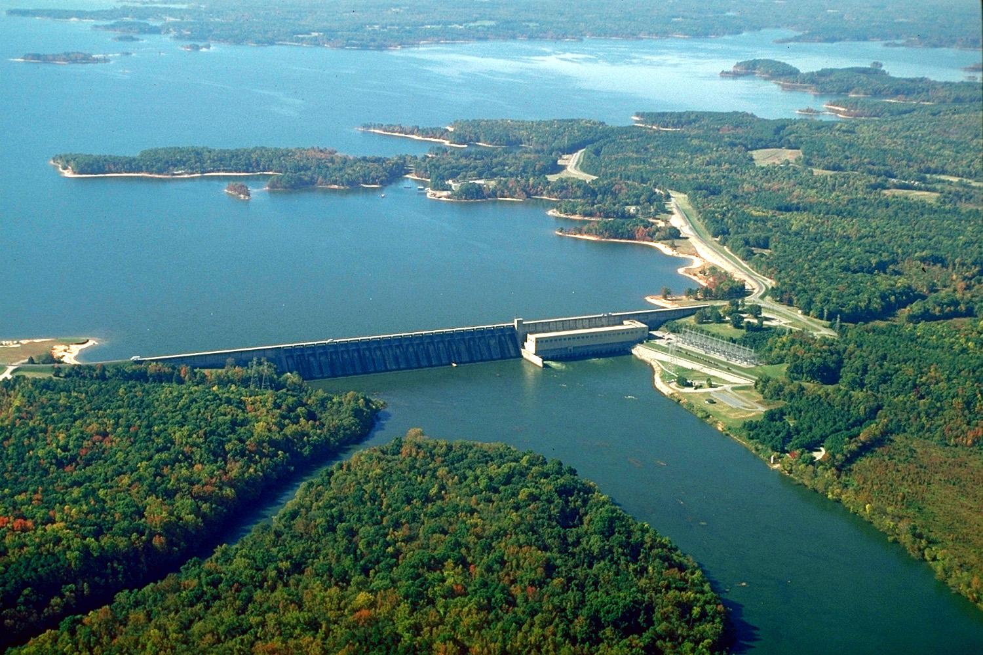
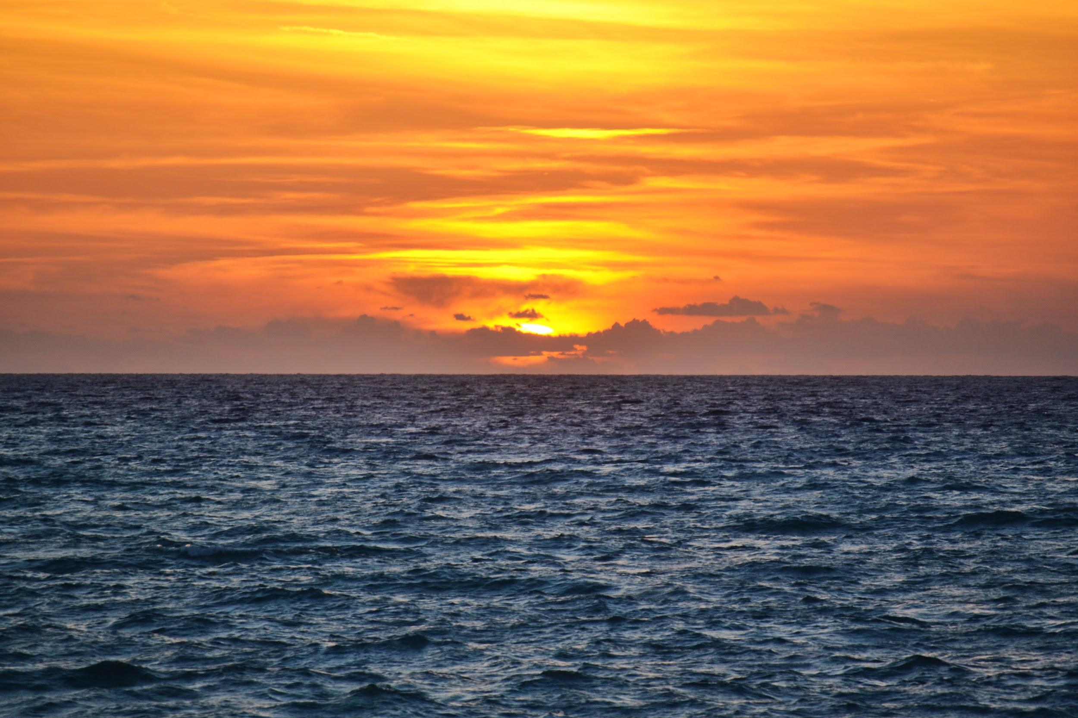
Blackbeard,Roanoke island,Scotch Bonnet
By: Jorge Henry Devin Daniel Rigo
Notes:
Title page: 20/20
3 accurate facts: 45/60
1 image: 10/10
4th grade language: 6/10
Total: 81/100

Slide 26
Scotch Bonnet
The officially name: the name is hence.
Other interesting fact:it is a rare shell.
Other interesting fact: It`s pattern of small orange squares.
Other interesting fact: it is 3 to 3 ½ inches in length fully grown.
Other interesting fact: it is a member of the helmet family.
Other interesting fact: jimmy johnson able to find only two scotch bonnet.
Why it is significant to nc: it is found in nc.
What they looked like:It looked like little girls hats they wear.

Slide 27
Blackbeard
1.When people heard the name Blackbeard they freaked out
2. Experts say Blackbeard had 2-14 wifes.
3.Blackbeard was experts creating a frightening image not only by how he looked,but by what he did.
4.He was most likely from england
5.He became captain in most likely a 1718.

Slide 28
Roanoke Island
Roanoke island is signif is located on the coast of North carolina.icant to North carolina because North carolina has symbols,flag,capital, and bodies.The first colony established Roanoke island.Roanoke island
Interesting facts
In 1590 white was finally able to secure passage back
to Roanoke island.
2. Nearly 4,000 North carolina enlisted,over 150 men.

